Slide 1

DIGIRAIL-TICKET VERIFICATION AND SEAT ALLOCATION
NAME OF THE STUDENTS:
A.Guruprakash-16EUEE040

Slide 2
ABSTRACT
It eliminates the problems in manual system of ticket verification and seat allocation in Indian railway
Our project idea is automated biometric system to verify passenger’s ticket through the biometric input
It consists of modules of reserved passengers’ fingerprints in respective compartments and authentication is done through aadhar card
GSM sends real time berth confirmation messages to RAC list passengers
Keyword: Biometric verification, GSM

Slide 3
OBJECTIVE
To provide the railway a foolproof automated seat allocation system
To eliminate favoritism and corruption in the allocation of seats to RAC passenger
To enhance the quality of the service of the railway to the passengers
To provide hassle free service in seat allocation

Slide 4
BACKGROUND
Passengers have to wait for the TTE for their authentication sacrificing their sleep and recreation.
RAC passengers have to wait for TTE for long hours
The quality of service is very low and slow
Rampant corruption

Slide 5
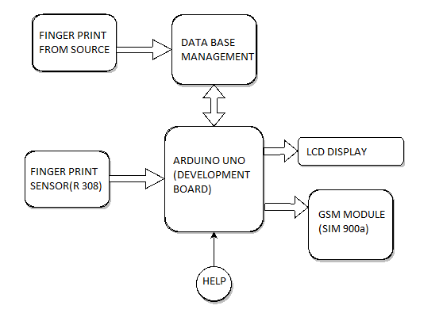
BLOCK DIAGRAM

Slide 6
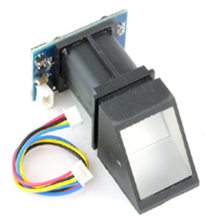
MAIN COMPONENTS
FINGER PRINT SENSOR
An intelligent module which image process the fingerprint and search and verify with stored fingerprint.(R-308)
Matching with module system will return the matching result as success or failure.

Slide 7
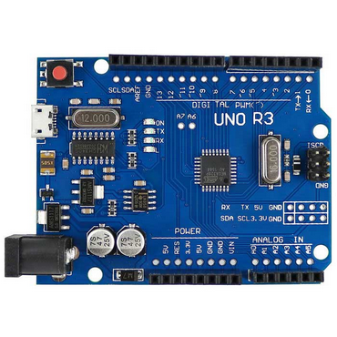
MAIN COMPONENTS
ARDUINO DEVELOPMENT BOARD
Arduino Uno is a microcontroller board based on the ATmega328P.
It has 14 digital input/output pins (of which 6 can be used as PWM outputs), 6 analog inputs, a 16 MHz quartz crystal, a USB connection, a power jack, an ICSP header and a reset button.

Slide 8
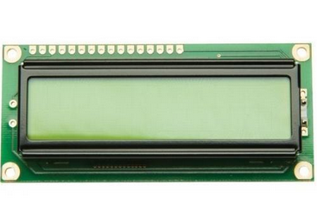
MAIN COMPONENTS
LCD
LCD (Liquid Crystal Display) screen is an electronic display module and find a wide range of applications.
A 16x2 LCD display is very basic module and is very commonly used in various devices and circuits.

Slide 9
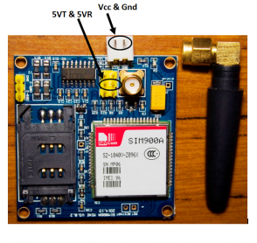
MAIN COMPONENTS
GSM MODULE
GSM/GPRS module is used to establish communication between a computer and a GSM-GPRS system.
Global System for Mobile communication (GSM) is an architecture used for mobile communication that enables higher data transmission rate.

Slide 10
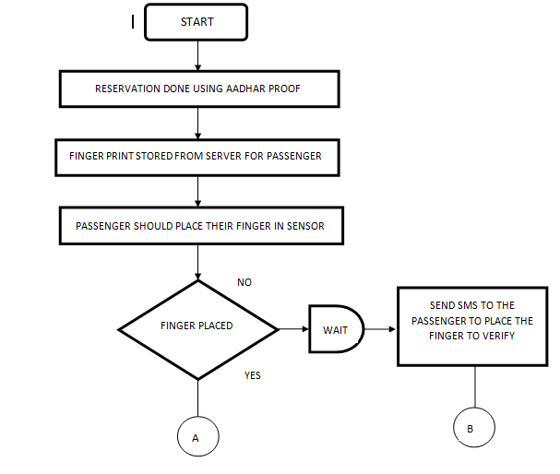
FLOW CHART

Slide 11
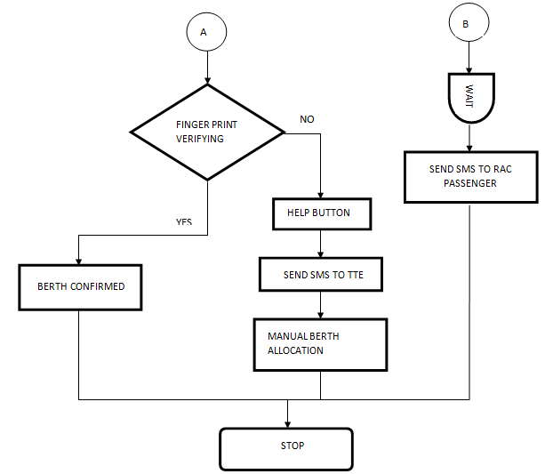
FLOW CHART

Slide 12
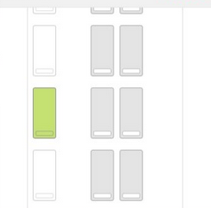
WORKING
PHASE I:
Scanning the fingerprint.
Image processing the fingerprint.
Comparing with reserved passengers’ fingerprints.
Updating the seat allocation status to the TTE.

Slide 13
WORKING
PHASE II:
If failed to register the fingerprint within 10 minutes from when train starts, a alert message will be sent to the respective passenger.
After that, seats will be allocated to the RAC passenger.

Slide 14
Future enhancement
For more accurate verification eye scanner sensor can be used with height adjustments.
Placing the Finger print after the journey to minimize the misuse of other passenger’s ticket while travelling.
Giving wake up calls for the passengers before the destination station.

Slide 15
Conclusion
This project aims at controlling fraudulence and improving transparency, errorless ticket verification and seat allocation process.
The work of the TTE (Travelling Ticket Examiner) will be minimized on the whole and his role can be redefined for the betterment of the railway.

Slide 16
QUERIES
?

